Slide 1
Introduction to JavaScript Events
As usual, please use the speaker notes for additional information!
Notes:
In this presentation, we will focus on events. The next presentation will cover more of the actual scripting.

Slide 2
Cautions!
JavaScript is very case sensitive
JavaScript should have each command written on one line
To be able to see source code effectively, I use Explorer
Notes:
Please read some notes on JavaScript. For today, focus on some of the rules involved and on the use of events.
Be sure to read about the concepts of objects, methods, objects and events to help you understand the code.

Slide 3
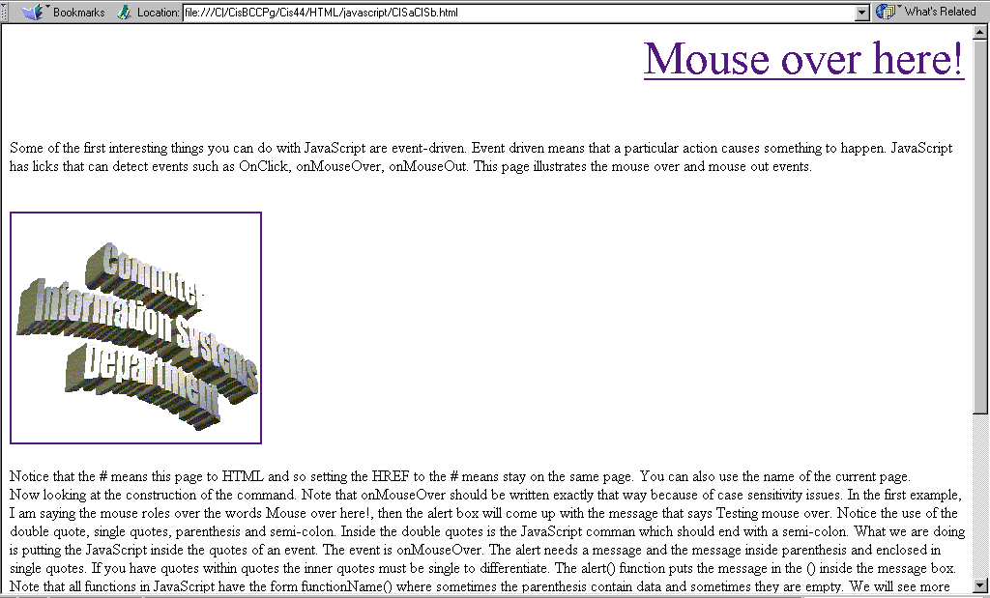
CISaCISb.html
Notes:
This is an example of mouse over using text and using an image box.

Slide 4
CISaCISb.html
In this case, the onMouseOver will bring up an alert message box . Note the use of quotes, the semicolon and the parenthesis which go with the alert() function.
# in the A HREF means same page.
<HTML>
<HEAD>
<TITLE>Rollover</TITLE>
</HEAD>
<BODY>
<P ALIGN=RIGHT>
<A HREF="#" onMouseOver = "alert('Testing mouse over!');">
<FONT SIZE=12>Mouse over here!</FONT></A></P>
Some of the first interesting things you can do with JavaScript are event-driven. Event
driven means that a particular action causes something to happen. JavaScript has licks that
can detect events such as onClick, onMouseOver, onMouseOut. This page illustrates the
mouse over and mouse out events.<BR><BR><BR>
<A HREF="#"
onMouseOver="document.CISimage.src='CISa.gif';"
onMouseOut="document.CISimage.src='CISb.gif';">
<IMG SRC="CISa.gif" NAME="CISimage"></A>
<BR><BR>
In this example onMouseOver shows one image and onMouseOut shows a different image. Note that CISimage is the name associated with the image that shows when the code is loaded. Again, note the use on quotation makes and semi-colons and the < > in the HTML surrounding the JavaScript.
Notes:
This shows the actual code using the onMouseOver and onMouseOut.

Slide 5
CISaCISb.html
Notice that the # means this page to HTML and so setting the HREF to the # means stay on the same page. You can also use the name of the current page.<BR> Now looking at the construction of the command. Note that onMouseOver should be written exactly that way because of case sensitivity issues. In the first example, I am saying
the mouse roles over the words Mouse over here!, then the alert box will come up with the message that says Testing mouse over. Notice the use of the double quote, single quotes, parenthesis and semi-colon. Inside the double quotes is the JavaScript comman which should end with a semi-colon. What we are doing is putting the JavaScript inside the
quotes of an event. The event is onMouseOver. The alert needs a message and the message inside parenthesis and enclosed in single quotes. If you have quotes within quotes the inner quotes must be single to differentiate. The alert() function puts the message in the () inside the message box. Note that all functions in JavaScript have the form
functionName() where sometimes the parenthesis contain data and sometimes they are empty. We will see more of this in later examples. Note one last thing that has nothing to do with JavaScript, because I wanted to Mouse over here! to be large and aligned to the right, I used the paragraph to align to the right and the font to change the font. These are not needed for the JavaScript.<BR>
On the next example, I am using both onMouseOver and onMouseOut. I went into PhotoEditor and did a invert with the CISa.gif image and saved it as CISb.gif. Then I can have one image show when the mouse rolls over the image and a second image show when the mouse rolls out.<BR>
When I work with an image, I need to be aware of the fact that frequently browers will not let the developer put events inside image tags. So what you have to do is set up the HREF equal to # and put the events inside that and then set up the image source with name as shown above. When the image is firstloaded it will show the image in IMG SRC which in this case is CISa.gif. When the mouse goes over that same image is shown. When the mouse goes out a different image is shown (in this case the inverted image). The dots in document.CISimage.src have special meaning to JavaScript. It will go to the last dot and work backward in the interpretation. So this essentially reads as change the src of CISimage which is in the document. This follows a document object model hierarchy (DOM) which can be referenced in many tutorials on JavaScript.<BR> To make things more efficient you can preload the images. I will illustrate a preload in another example.<BR>
One other thing to note - because single and double quotes have special meanings, you cannot use them in the ordinary way in your text. If you want to use the quotes in your text you do it with Jane\'s where the \ tells JavaScript to use the single quote instead of interpreting it.
Notes:
This shows some explanatory notes that are included in the code.

Slide 6
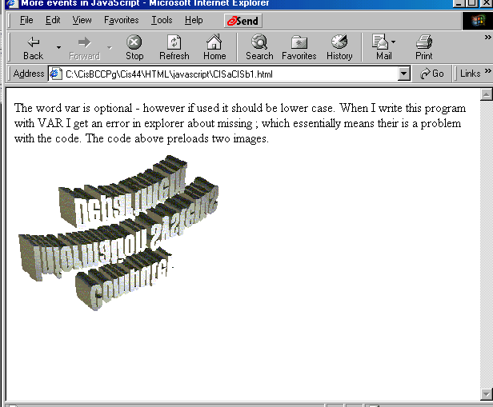
CISaCISb1.html
Notes:
This shows the results of the next page, CISaCISb1.html.

Slide 7
CISaCISb1.html
Load the images. The variable name where they are put are CISa_image and CISb_image.
<HTML>
<HEAD>
<TITLE>More events in JavaScript</TITLE>
<SCRIPT language="JavaScript">
var CISa_image = new Image();
CISa_image.src = "CISa.gif";
var CISb_image = new Image();
CISb_image.src = "CISb.gif";
</SCRIPT>
The word var is optional - however if used it should be lower case.
When I write this program with VAR I get an error in explorer about missing ; which
essentially means their is a problem with the code.
</HEAD>
<BODY>
The code above preloads two images.<BR>
<A HREF="#"
onMouseOver="CISimage.src='CISa.gif';"
onMouseOut="CISimage.src='CISb.gif';">
<IMG SRC="CISb.gif" NAME="CISimage" BORDER = 0></A>
</BODY>
</HTML>
In this example I am simply giving the image name.
This time the CISb.gif is loaded when the form is shown.
Notes:
This shows the code with the preload of the images done in JavaScript in the header.
Note that with things other than events, JavaScript is enclosed in the SCRIPT shown. It is better to include the clause language = "JavaScript" since ther are other scripting languages.
In the previous example instead of CISimage I used document.CISimage. I could also have used window.document.CISimage.

Slide 8
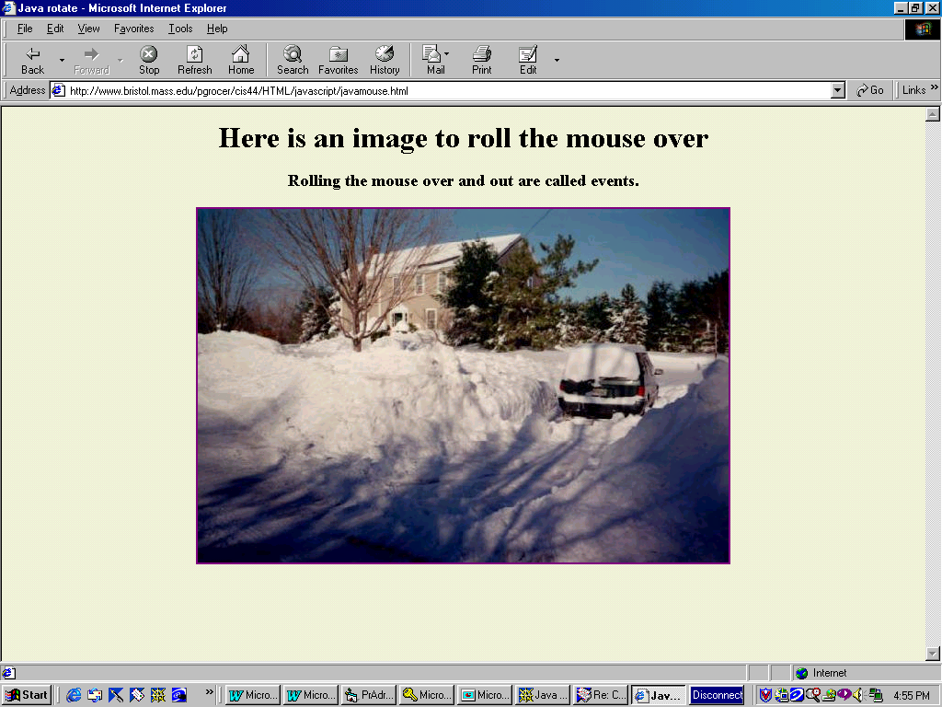
Notes:
This is the program called javamouse.html. Rolling the mouse over the picture causes it to appear up side down. This is because there are two images. In a graphics package I saved the image, then rotated it 180 degrees and saved it again under a different name.

Slide 9
javamouse.html
This code establishes a new Image called originalz and then specifies the source for this image as house.jpg.
It then establishes another new image called flipz and then specifies that the source for this image is houseusd.jpg.
<HTML>
<HEAD>
<TITLE>Java rotate</TITLE>
<SCRIPT>
originalz = new Image;
originalz.src="house.jpg";
flipz = new Image;
flipz.src = "houseusd.jpg";
</SCRIPT>
</HEAD>
<BODY bgcolor=beige>
<DIV ALIGN=CENTER>
<H1>Here is an image to roll the mouse over</H1>
<H3>Rolling the mouse over and out are called events.</H3>
<A HREF="javamouse.html"
onMouseOver="document.myhouse.src = flipz.src"
onMouseOut="document.myhouse.src = originalz.src">
<IMG SRC="house.jpg"
NAME="myhouse"></A>
</DIV>
</BODY>
</HTML>
Note I used the defined image name and not the .jpg name.
Document refers to the object of the window that is being worked with.
This means the original image shown is house.jpg
The events are associated with the A HREF which refers to this page. The events say take the current document or window and then the name associated with the image and make the source the sources that were specified in the <HEAD>.
Notes:
In the SCRIPT in <HEAD> I establish the two images and name them originalz and flips. Establishing the images in the <HEAD> means that they will be loaded initially and there will not be a delay in the mouse over and mouse out events.
Please read an explanation of this click event in one of the many tutorials and fact sheets available on the Web. The explanation here needs to be elaborated on.
Note that in this example, I used the name defined in the script for the image instead of the actual .jpg name. In previous examples I used the actual image name enclosed in quotes.

Slide 10
<HTML>
<HEAD>
<TITLE>Java rotate</TITLE>
<SCRIPT language = "JavaScript">
<!--hide from browser that do not support
var originalz = new Image;
originalz.src="house.jpg";
var flipz = new Image;
flipz.src = "houseusd.jpg";
// end of the hide -->
</SCRIPT>
</HEAD>
<BODY bgcolor=beige>
<DIV ALIGN=CENTER>
<H1>Here is an image to roll the mouse over</H1>
<H3>Rolling the mouse over and out are called events.</H3>
<A HREF="javamouse.html"
onMouseOver="document.myhouse.src = flipz.src;"
onMouseOut="document.myhouse.src = originalz.src;">
<IMG SRC="house.jpg"
NAME="myhouse"></A>
</DIV>
Here are a few comments on the program.
<UL>
<LI>I did not include langauge = "JavaScript" in
the SCRIPT of the original program because it is not required. It is a good thing to do
because other languages can be used for scripting, such as VB.
<LI>This code includes the Hide me if the browser does not support JavaScript code.
<LI>var is not required so I did not use it in the previous example.
<LI>the semi-colons are not required after the mouse over and out and I did not use them
in the previous example
</BODY>
</HTML>
Notes:
This version is a little more "professionally done".

Slide 11
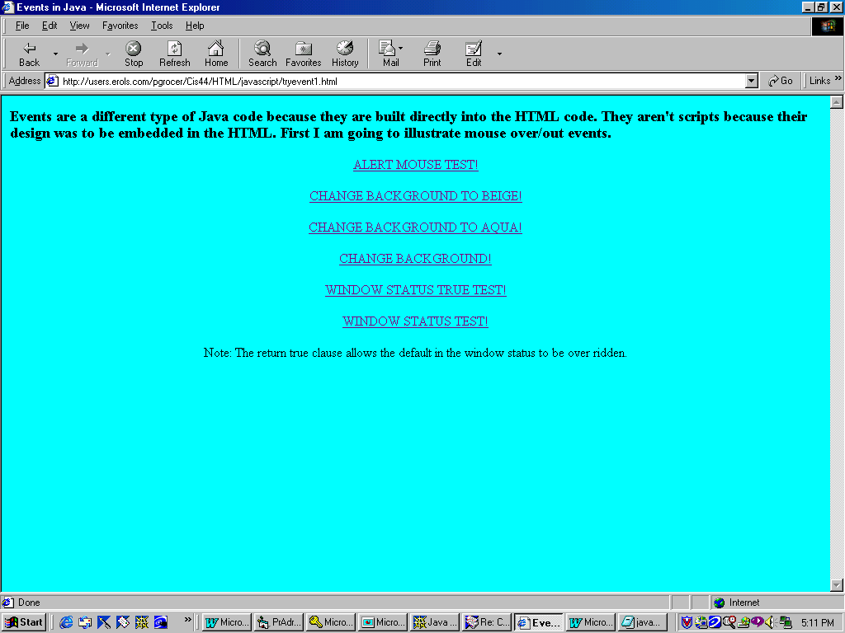
Notes:
This is try event one. It experiments with other uses of the mouse over and mouse off. The code is on the next page.
I got this code by opening source in Explorer 5.0 which shows the JavaScript.

Slide 12
tryevent1.html
Different things are happening as a result of the onMouseOver event. In the first example, a popup alert window comes up. In the second the background changes to beige.
<HTML>
<HEAD>
<TITLE>Events in Java</TITLE>
</HEAD>
<BODY bgcolor=aqua>
<H3>Events are a different type of Java code because they are built directly into the HTML code.
They aren't scripts because their design was to be embedded in the HTML. First I am
going to illustrate mouse over/out events.</H3>
<P ALIGN=CENTER>
<A HREF="tryevent1.html"
onMouseOver="alert('Testing events...')">ALERT MOUSE TEST!</A>
<BR><BR>
<A HREF="tryevent1.html"
onMouseOver="document.bgColor='beige'">CHANGE BACKGROUND TO BEIGE!</A>
<BR><BR>
<A HREF="tryevent1.html"
onMouseOver="document.bgColor='aqua'">CHANGE BACKGROUND TO AQUA!</A>
<BR><BR>
<A HREF="tryevent1.html"
onMouseOver="document.bgColor='pink'"
onMouseOut="document.bgColor='green'">CHANGE BACKGROUND!</A>
<BR><BR>
<A HREF="tryevent1.html"
onMouseOver="window.status='Testing roll over'; return true"
onMouseOut="window.status='Testing roll out'; return true">WINDOW STATUS TRUE TEST!</A>
<BR><BR>
<A HREF="tryevent1.html"
onMouseOver="window.status='Testing roll over'"
onMouseOut="window.status='Testing roll out'">WINDOW STATUS TEST!</A>
<BR><BR>
Note: The return true clause allows the default in the window status to be over ridden.
</P>
</BODY>
</HTML>
Notes:
Again we are referring to document as the object and in this case bgColor is a property of the document object.
Note that in JavaScript the syntax is:
Event="document.property or method"
If you need quotes within the quotes, the inner quotes are done with single quotes.
In the case of alert we are talking about a different object - a popup alert window that comes up and in the case of window.status we are talking about the object window and the status of that window.

Slide 13
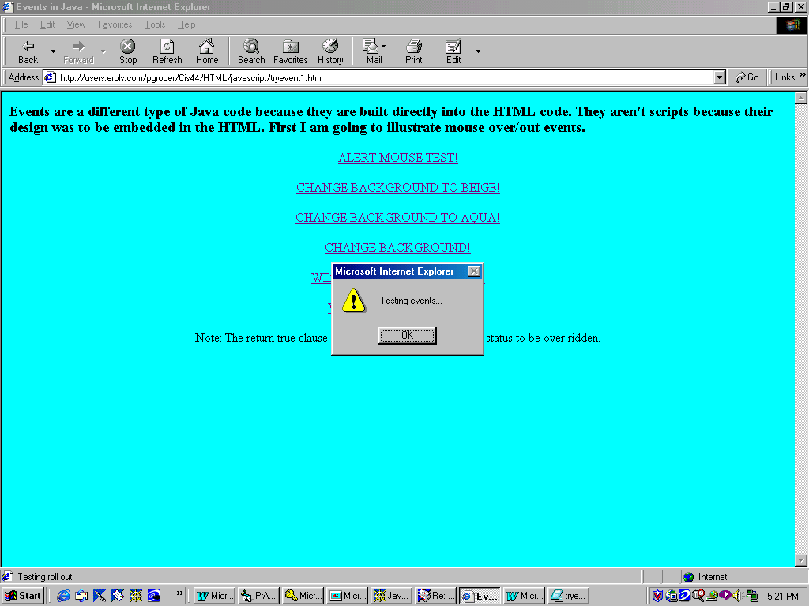
This slide shows the result of moving the mouse over the ALERT MOUSE TEST. The code behind this line is shown below.
<A HREF="tryevent1.html"
onMouseOver="alert('Testing events...')">ALERT MOUSE TEST!</A>
Notes:
This slide shows the alert which brings up the alert popup window which displays the message inside the parenthesis.

Slide 14
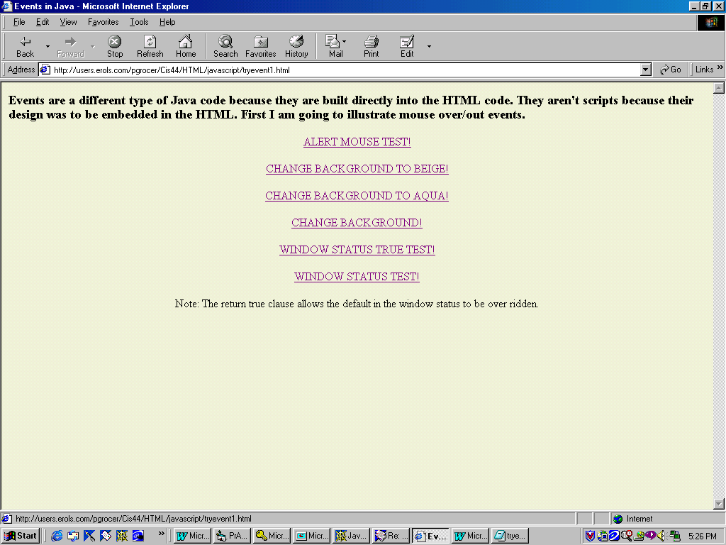
This shows the results of running the mouse over CHANGE BACKGROUND TO BEIGE! The code is shown below.
<A HREF="tryevent1.html"
onMouseOver="document.bgColor='beige'">CHANGE BACKGROUND TO BEIGE!</A>
Note that “document.bgcolor=‘beige’” is enclosed in double quotes and the word ‘beige’ is enclosed in single quotes because it is embedded in double quotes and trying to use double quotes would confuse the structure of the command.
Notes:
Read about the use of quotes in JavaScript in one of the tutorials.

Slide 15

<A HREF="tryevent1.html"
onMouseOver="window.status='Testing roll over'; return true"
onMouseOut="window.status='Testing roll out'; return true">WINDOW STATUS TRUE TEST!</A>
Notes:
Note the Testing roll over in the window status.
return true "locks" the message into the status line so it won't be replaced by the default URL.

Slide 16

<A HREF="tryevent1.html"
onMouseOver="window.status='Testing roll over'; return true"
onMouseOut="window.status='Testing roll out'; return true">WINDOW STATUS TRUE TEST!</A>
Notes:
Compare this to the next set which does not have the return true.

Slide 17

<A HREF="tryevent1.html"
onMouseOver="window.status='Testing roll over'"
onMouseOut="window.status='Testing roll out'">WINDOW STATUS TEST!</A>
Notes:
Without return true, the default URL appears.

Slide 18
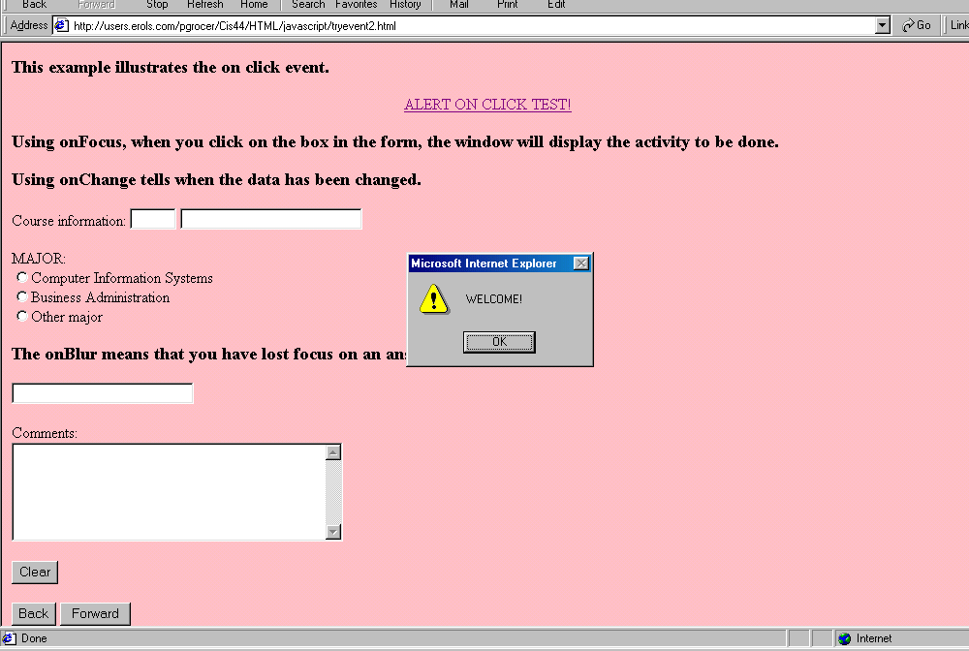
<BODY bgcolor=pink onLoad="alert('WELCOME!')">
Notes:
In this example, the BODY statement has an onLoad event which displays the alert window when the page is opened.

Slide 19
tryevent2.html
<HTML>
<HEAD>
<TITLE>Events in Java</TITLE>
</HEAD>
<BODY bgcolor=pink onLoad="alert('WELCOME!')">
<H3>This example illustrates the on click event.</H3>
<P ALIGN=CENTER>
<A HREF="tryevent2.html"
onClick="alert('Testing events...')">ALERT ON CLICK TEST!</A>
<BR><BR>
</P>
<H3>Using onFocus, when you click on the box in the form, the window will display the
activity to be done.</H3>
<H3>Using onChange tells when the data has been changed.</H3>
<FORM NAME="crsform">
Course information:
<INPUT TYPE="text" SIZE=5 NAME="crscode"
onFocus="window.status='Enter course code'">
<INPUT TYPE="text" SIZE=25 NAME="crsname"
onFocus="window.status='Enter course name'";
onChange="alert('The data has been changed')";>
<BR><BR>
<P>MAJOR:<BR>
<INPUT TYPE="RADIO" NAME="major" VALUE="CI">Computer Information Systems<BR>
<INPUT TYPE="RADIO" NAME="major" VALUE="BU">Business Administration<BR>
<INPUT TYPE="RADIO" NAME="major" VALUE="other">Other major<BR>
<H3>The onBlur means that you have lost focus on an answer.</H3>
<INPUT TYPE="text" SIZE=25 NAME="crsinst"
onFocus="window.status='Enter instructor name'";
onBlur="alert('Did you enter instructor name?')";>
<P>Comments:<BR>
<TEXTAREA ROWS="6" COLS="40" NAME="Comments"></TEXTAREA>
<P>
<INPUT TYPE="RESET" VALUE="Clear">
<P>
<INPUT TYPE="BUTTON" VALUE="Back" onClick="history.go(-1)">
<INPUT TYPE="BUTTON" VALUE="Forward" onClick="history.go(1)">
</FORM>
</BODY>
</HTML>
Notes:
The code for tryevent2.html.

Slide 20
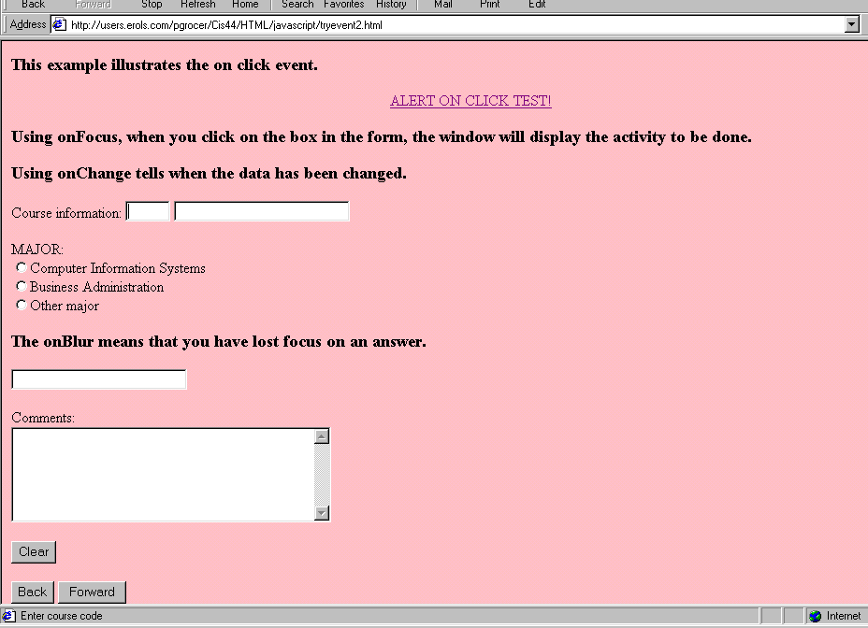
<INPUT TYPE="text" SIZE=5 NAME="crscode"
onFocus="window.status='Enter course code'">
Notes:
This causes Enter course code to show on the status line when the focus is on the first box after Course information.

Slide 21
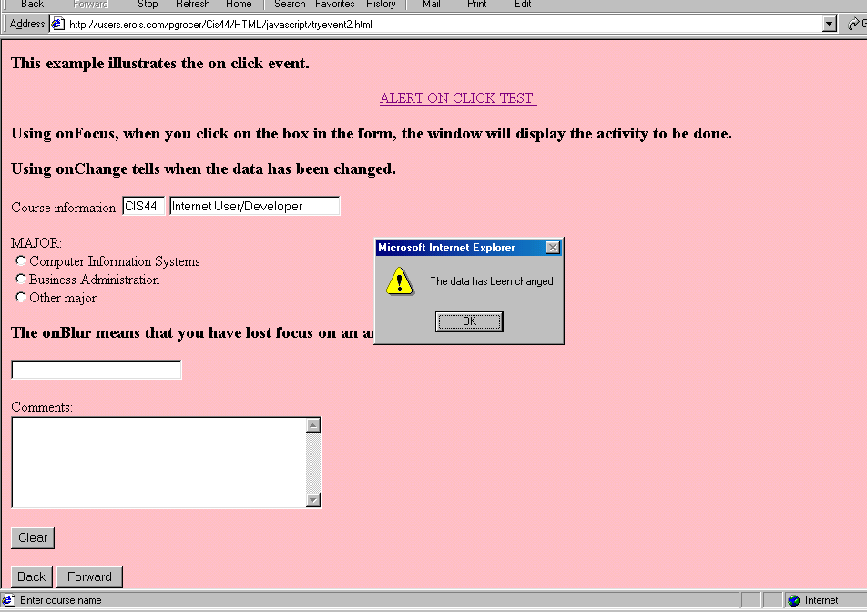
<INPUT TYPE="text" SIZE=25 NAME="crsname"
onFocus="window.status='Enter course name'";
onChange="alert('The data has been changed')";>
Notes:
When the course name got the focus, the message appeared on the status line. When I left the course name (NAME="crsnmae") then the alert window appeared.

Slide 22
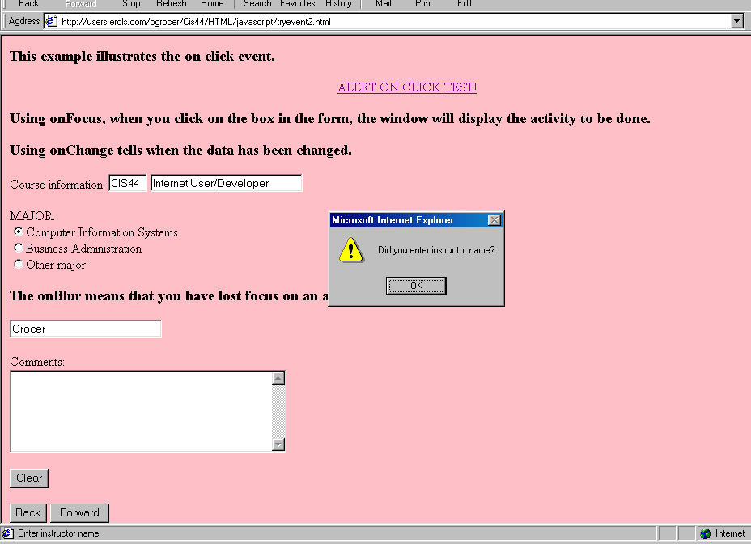
<INPUT TYPE="text" SIZE=25 NAME="crsinst"
onFocus="window.status='Enter instructor name'";
onBlur="alert('Did you enter instructor name?')";>
Notes:
When I left the instructor box (NAME="crsinst") the onBlur was activated and the alert popup message appeared.

Slide 23
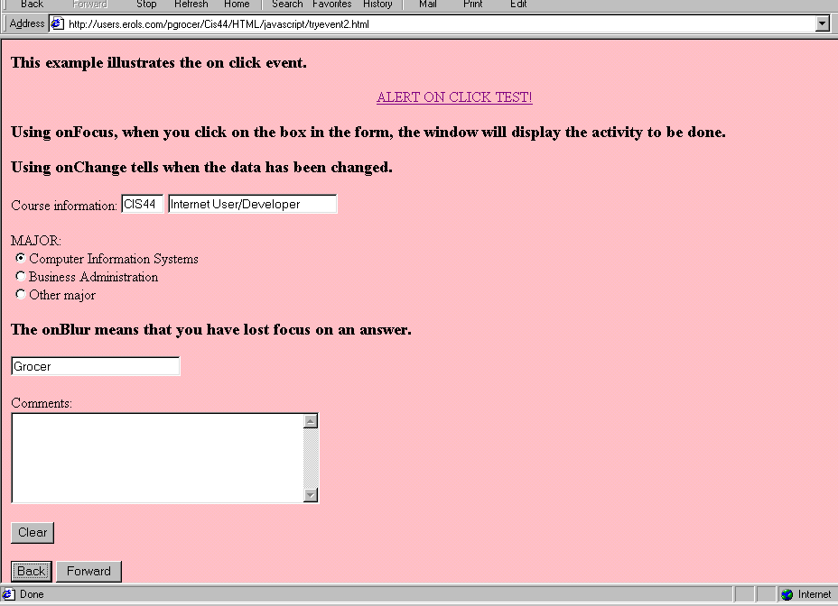
<INPUT TYPE="BUTTON" VALUE="Back" onClick="history.go(-1)">
<INPUT TYPE="BUTTON" VALUE="Forward" onClick="history.go(1)">
Notes:
history.go(-1) moves back one screen
history.go(1) moves forward one screen
Different numbers can be used to control where you go.

Slide 24
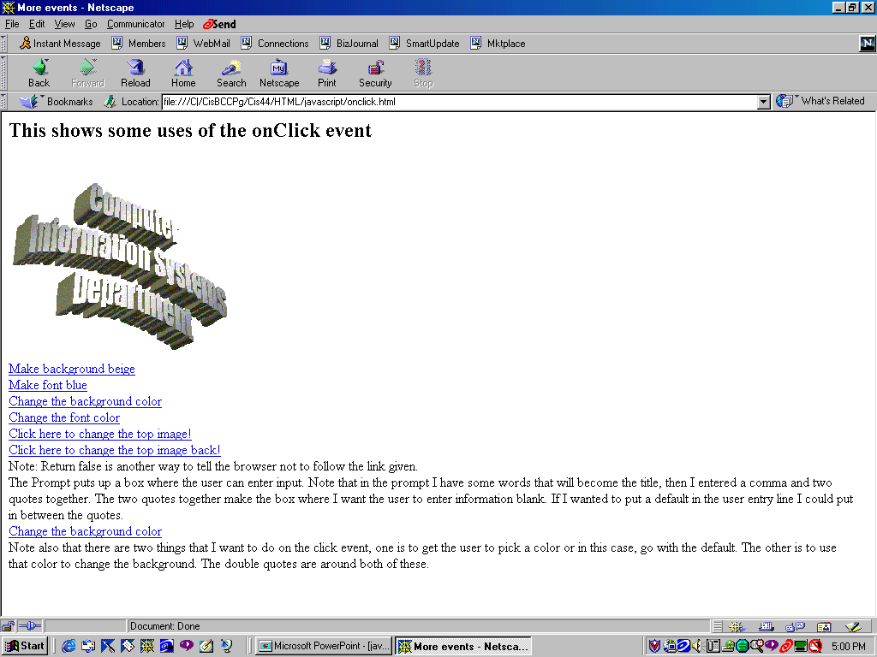
Notes:
This shows a page with a variety of onClick options. You can change background color, default font color, or the image and you can get user input on the colors to use.

Slide 25
onClick.html
The prompt calls for title, data for the input box. In the first case, I want nothing in the input box. In the second case I am using a default of pink. This is shown on the next page.
<HTML>
<HEAD>
<TITLE>More events</TITLE>
<SCRIPT language="JavaScript">
var mycolor;
var myfont;
</SCRIPT>
</HEAD>
<BODY>
<H2>This shows some uses of the onClick event</H2>
<IMG SRC="CISa.gif" NAME="originalz"><BR>
<A HREF = "#"
onClick="window.document.bgColor='beige'";>Make background beige</A><BR>
<A HREF = "#"
onClick="window.document.fgColor='blue'";>Make font blue</A><BR>
<A HREF="#"
onClick="mycolor=prompt('Enter your choice of background color','');
window.document.bgColor=mycolor;">Change the background color</A><BR>
<A HREF="#"
onClick="myfont=prompt('Enter your choice of font color','');
window.document.fgColor=myfont;">Change the font color</A><BR>
<A HREF="#"
onClick="document.originalz.src='CISb.gif';">Click here to change the top image!</A><BR>
<A HREF="#"
onClick="document.originalz.src='CISa.gif';
return false;">Click here to change the top image back!</A><BR>
Notes:
This shows the onClick code. Note that the prompt asks for user input.
Note that bgColor is background color and fgColor is the default font color - I assume fg means foreground color.

Slide 26
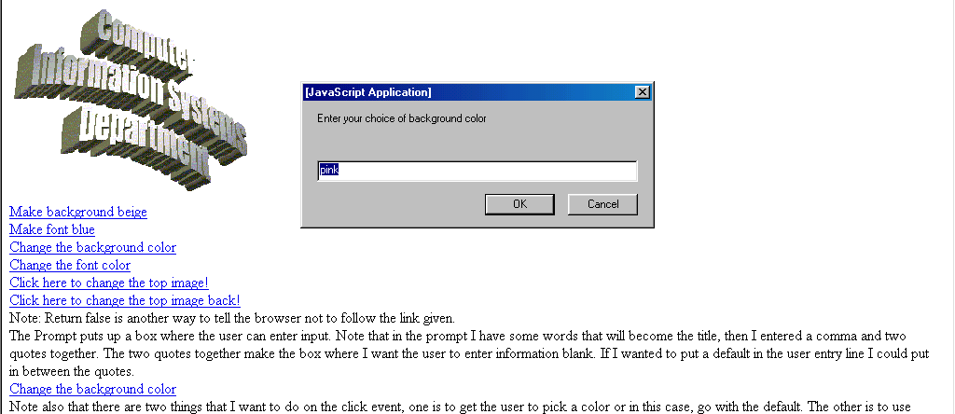
onClick.html
Note: Return false is another way to tell the browser not to follow the link given.<BR>
The Prompt puts up a box where the user can enter input. Note that in the prompt I have
some words that will become the title, then I entered a comma and two quotes together. The
two quotes together make the box where I want the user to enter information blank. If
I wanted to put a default in the user entry line I could put in between the quotes.<BR>
<A HREF="#"
onClick="mycolor=prompt('Enter your choice of background color','pink');
window.document.bgColor=mycolor;">Change the background color</A><BR>
Note also that there are two things that I want to do on the click event, one is to get
the user to pick a color or in this case, go with the default. The other is to use that
color to change the background. The double quotes are around both of these.
</BODY>
</HTML>
Notes:
As mentioned on the previous page. This prompt will ask for a choice of color and give the default of pink.

Slide 27
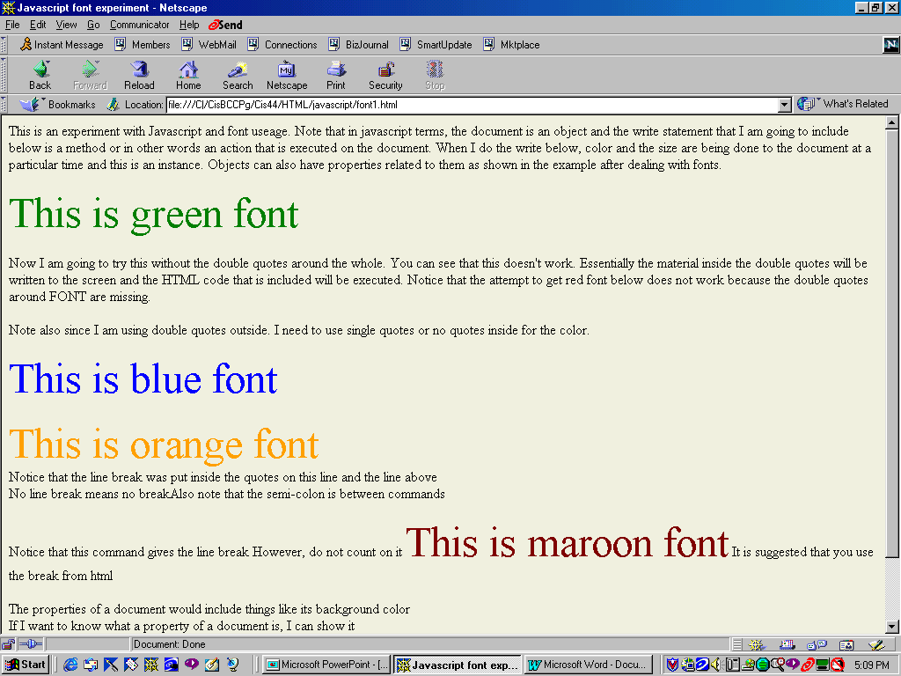
Notes:
This shows font1.html. Note that font2.html is cleaned up a little and it is missing the purposeful error on this slide. You should look at the code for both.

Slide 28
Font1.html
<HTML>
<HEAD>
<TITLE>Javascript font experiment</TITLE>
</HEAD>
<BODY BGCOLOR=beige>
This is an experiment with Javascript and font useage. Note that in javascript terms, the
document is an object and the write statement that I am going to include below is a method
or in other words an action that is executed on the document. When I do the write below,
color and the size are being done to the document at a particular time and this is an instance.
Objects can also have properties related to them as shown in the example after dealing
with fonts.
<BR><BR>
<SCRIPT LANGUAGE="javascript">
document.write("<FONT COLOR='GREEN' SIZE=150%>This is green font</FONT>")
</SCRIPT>
<BR><BR>
Now I am going to try this without the double quotes around the whole. You can see that this
doesn't work. Essentially the material inside the double quotes will be written to the screen
and the HTML code that is included will be executed. Notice that the attempt to get red font
below does not work because the double quotes around FONT are missing.
<BR><BR>
<SCRIPT LANGUAGE="javascript">
document.write(<FONT COLOR="RED" SIZE=150%>This is red font</FONT>)
</SCRIPT>
Note also since I am using double quotes outside. I need to use single quotes or no quotes
inside for the color.
<BR><BR>
<SCRIPT LANGUAGE="javascript">
document.write("<FONT COLOR=BLUE SIZE=150%>This is blue font</FONT>")
</SCRIPT>
Notes:
This is illustrating the use of the document.write() with a variety of different options. Please look at font1.html and font2.html.

